Slide 1
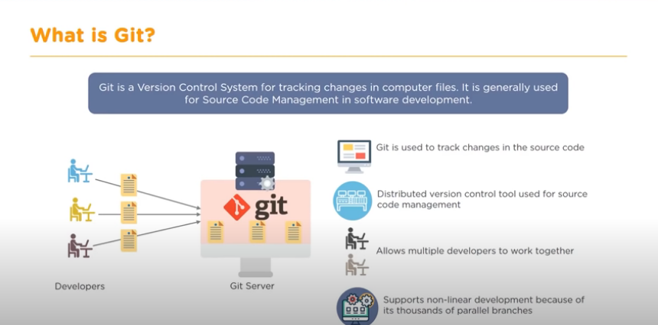

Slide 2
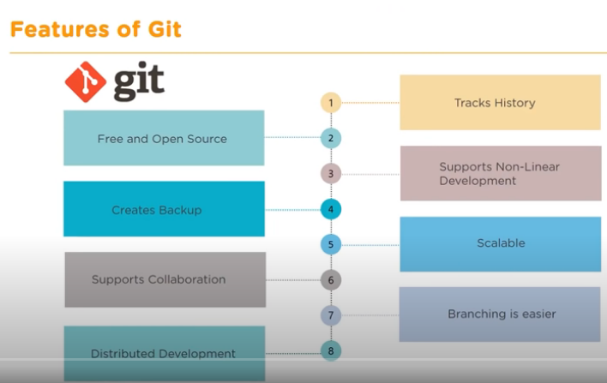

Slide 3
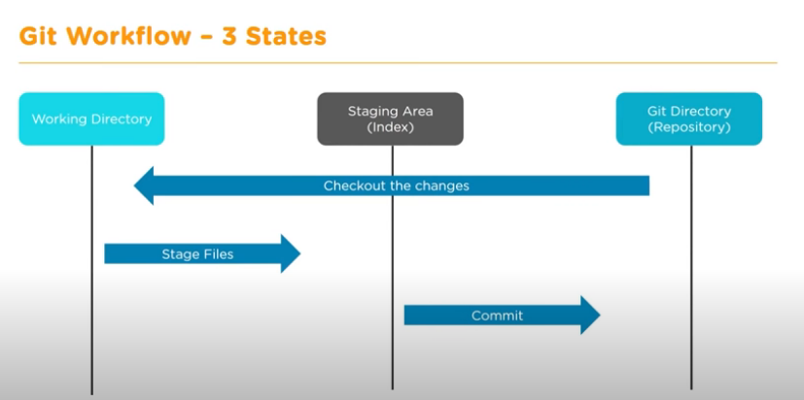

Slide 4
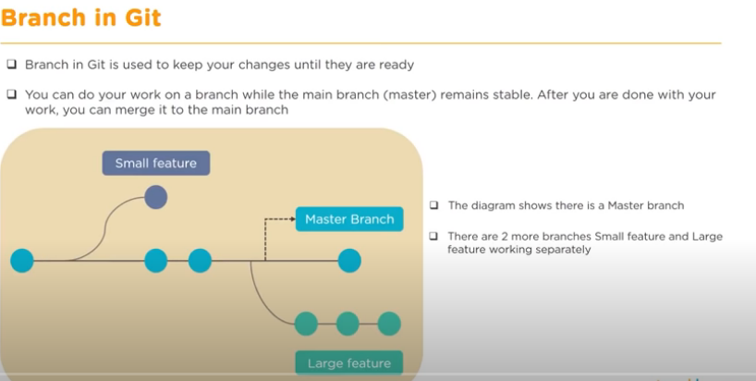

Slide 5
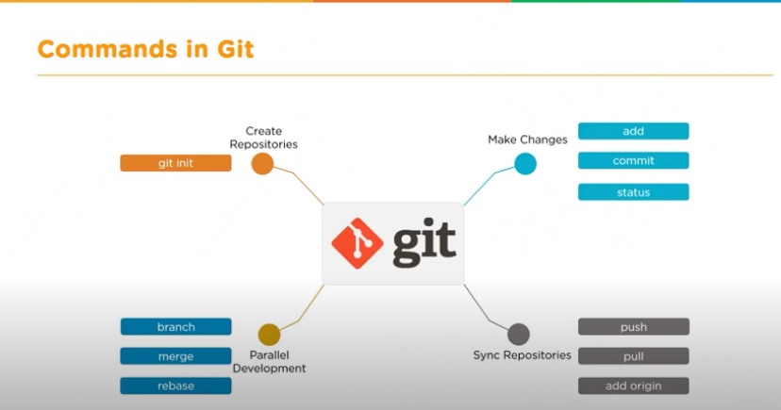

Slide 6


Slide 7
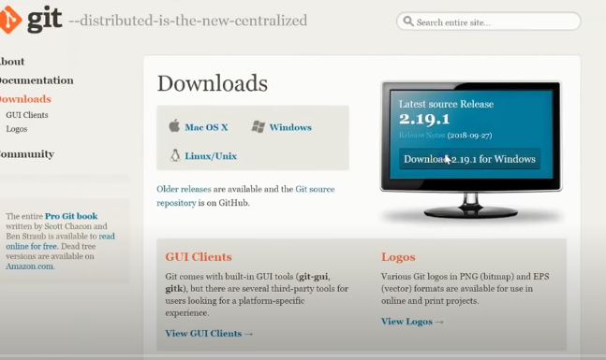

Slide 8
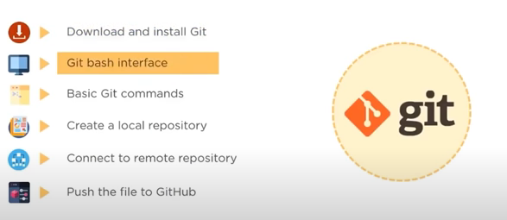

Slide 9
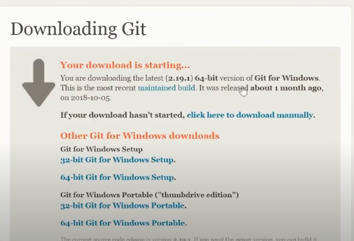

Slide 10
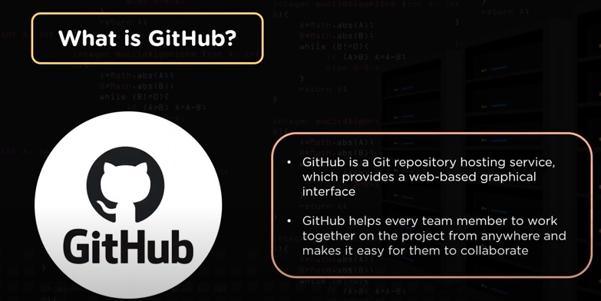

Slide 11
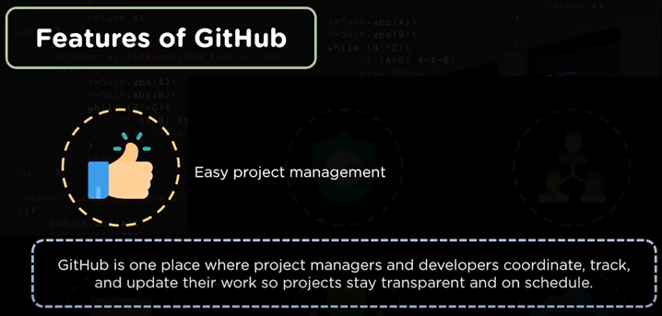

Slide 12
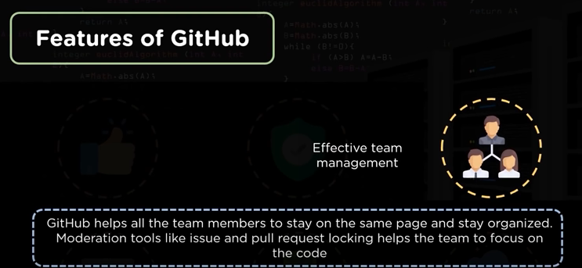

Slide 13
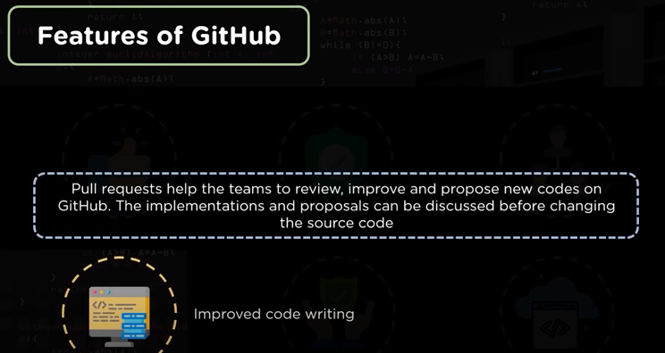

Slide 14
Git | GitHub
Git is software. | It is a service.
Linux maintains Git. | Microsoft maintains GitHub.
It is a command-line tool. | It is a graphical user interface.
You can install it locally on the system. | It is hosted on the web. It is exclusively cloud-based.
It is a VCS to manage source code history | It is a hosting service for Git repositories.
It focuses on code sharing and version control. | It focuses on centralized source code hosting.
It lacks a user management feature. | It has a built-in user management feature.
Git was launched in 2005. | GitHub was released in 2008.
Git has minimum external tool configuration. | It has an active marketplace for tool integration.
It is open-source licensed. | It has a free-tier and pay-for-use tier.

Slide 15
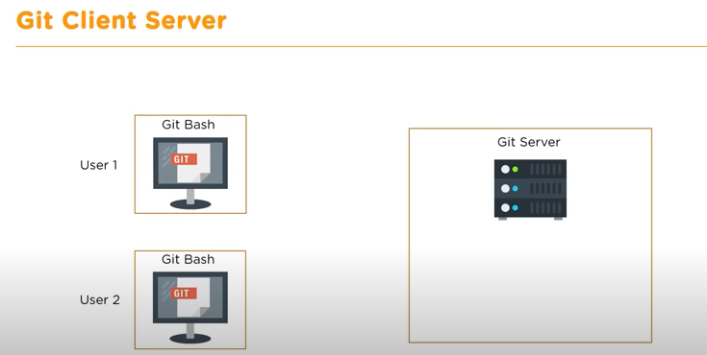

Slide 16
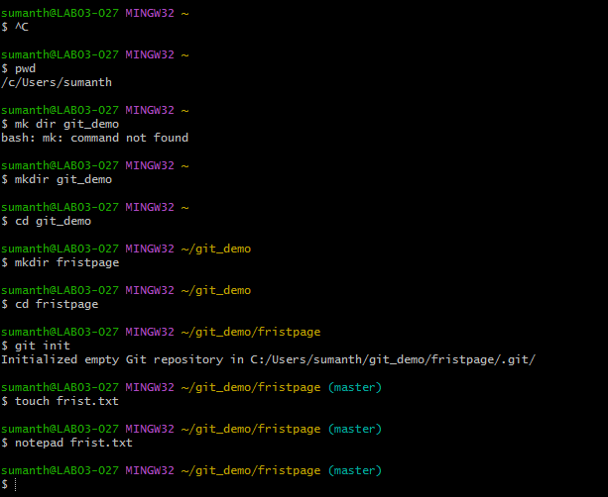

Slide 17
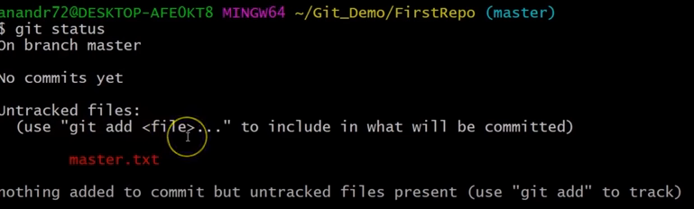

Slide 18
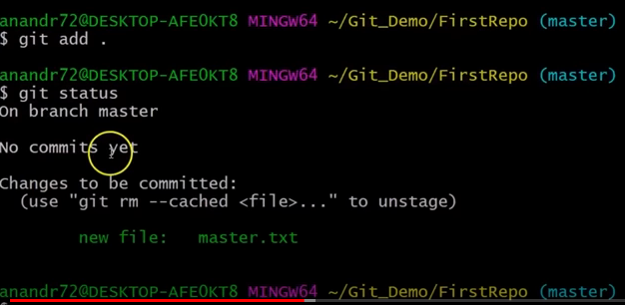

Slide 19
